Slide 1
Chapter 1
Continuous-time
Signals Analysis

Slide 2
Main Contents
Commonly used continuous time signal
Time domain analysis of continuous time
signal
Frequency domain analysis of continuous time signal
---Fourier Series for Periodic signal
---Fourier Transform for nonperiodic
signal

Slide 3
§1.1 Introduction
Any problems about signal analysis and processing may be thought of letting signals trough systems.
f(t)
h(t)
y(t)
From f(t) and h(t)，find y(t)， Signal processing
From f(t) and y(t) ，find h(t) ，System design
From y(t) and h(t)，find f(t) ， Signal reconstruction

Slide 4
§1.1 Introduction
There are so many different signals and systems that it is impossible to describe them one by one
The best approach is to represent the signal as a combination of some kind of most simplest signals which will pass through the system and produce a response. Combine the responses of all simplest signals, which is the system response of the original signal.
This is the basic method to study the signal analysis and processing.

Slide 5
Signals are divided into two kinds:
1.Determinite signal
2.Random signal
This course is only related with
determinite signal.

Slide 6
§1.2 Continue-time Signal
All signals are thought of as a pattern of
variations in time and represented as a time
function f(t).
In the real-world, any signal has a start. Let
the start as t=0 that means
f(t) = 0 t<0
Call the signal causal.

Slide 7
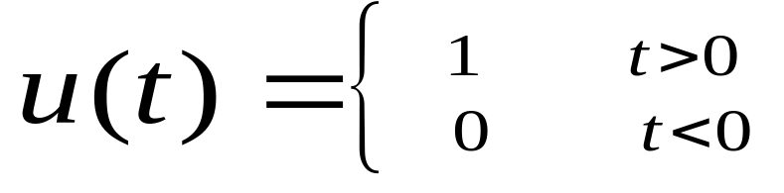
§1.2 .1 Typical signals and their representation
Unit Step u(t) (in our textbook μ(t))
u(t)
u(t- t₀)
1
1
0
t
0
t₀
t
u(t) is basic causal signal, multiply which with any non-causal signal to get causal signal.

Slide 8
§1.2 .1 Typical signals and their representation
Sinusoidal: Asin(ωt+φ)
f(t) = Asin(ωt+φ)= Asin(2πft+φ)
A --- Amplitude
f ---frequency(Hz)
ω= 2πf angular frequency (radians/sec)
φ – start phase(radians)

Slide 9
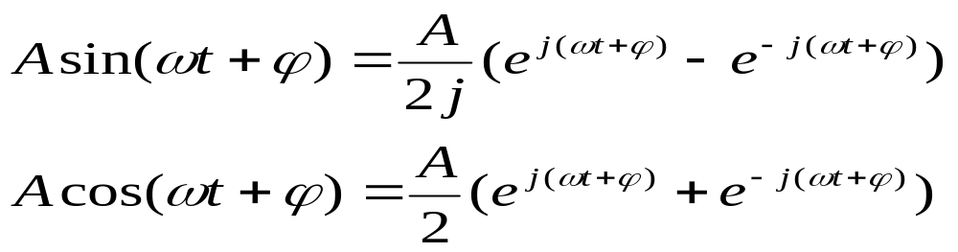
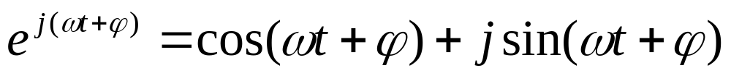
§1.2 .1 Typical signals and their representation
sin/cos signals may be represented by
complex exponential
Euler’s relation

Slide 10
§1.2 .1 Typical signals and their representation
Sinusoidal is basic periodic signal which is important both in theory and engineering.
Sinusoidal is non-causal signal. All of periodic signals are non-causal because they have no start and no end.
f (t) = f (t + mT) m=0, ±1, ±2, ···, ±∞

Slide 11
§1.2 .1 Typical signals and their representation
Exponential f(t) = e^{αt}
α is real
α <0 decaying
α =0 constant
α >0 growing

Slide 12
§1.2 .1 Typical signals and their representation
Exponential f(t) = e^{αt}
α is complex α = σ + jω
f(t) = Ae ^{αt} = Ae^{(σ + jω)t}
= Ae^{σ t} cos ωt + j Ae^{σ t} sin ωt
σ = 0, sinusoidal
σ > 0 , growing sinusoidal
σ < 0 , decaying sinusoidal (damped)

Slide 13
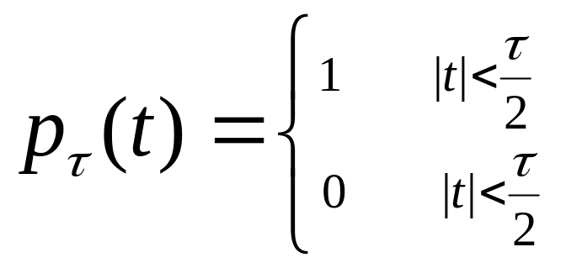
§1.2 .1 Typical signals and their representation
Gate signal
1
-τ/2
τ/2
The gate signal can be represented by unit step signals:
P_{τ}(t) = u(t + τ/2) – u(t – τ/2)

Slide 14
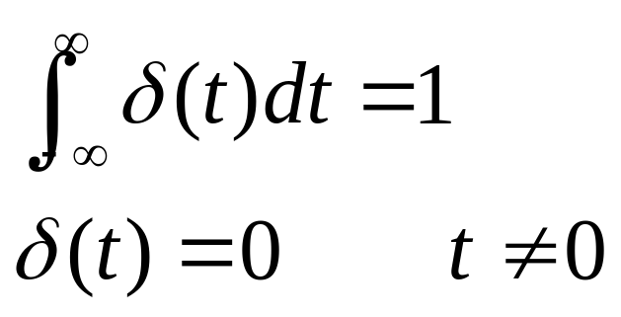
§1.2 .1 Typical signals and their representation
Unit Impulse Signal
δ(t)
(1)
t
0
δ(t) is non-zero only at t=0，otherwise is 0
δ(t) could not be represented by a constant even at
t=0，but by an integral.
Regular function has exact value at exact time. Obviously，δ(t) is not a Regular function.

Slide 15
Unit impulse function δ(t)
With a gate signal p_{τ}(t), short the duration τ and keep the unit area
4/τ
2/τ
1/τ
1/τ
-τ/2
τ/2
τ/4
-τ/8
τ/8
-τ/4
When τ→0, the amplitude tends to ∞, which means it is impossible to define δ(t) by a regular function.

Slide 16
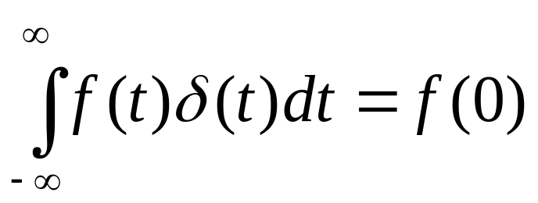
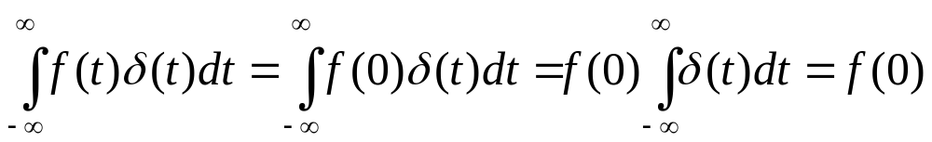
Properties of δ(t)
Sampling Property
Briefly understanding：
When t ≠ 0, δ(t)=0, then f(t)●δ(t)=0
When t = 0, f(t) = f(0) is a constant. Based on the definition of δ(t), it is easy to get:

Slide 17
Properties of δ(t)
δ(t) shift
δ(t)
δ(t- τ )
0
τ
t
0
t
δ(t) times a constant A:
Aδ(t)
A is called impulse intension which is the area of the integral

Slide 18
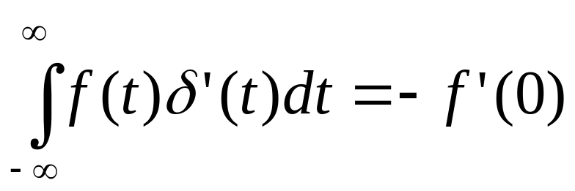
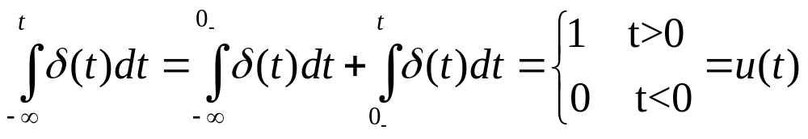
Properties of δ(t)
Differential of δ(t) is also an impulse
δ’(t) = dδ(t)/dt and
Integral of δ(t) is unit step signal:

Slide 19
Properties of δ(t)
δ(t) is a even function, that is
δ(t) = δ(-t)
We got δ(t) from a gate signal, and gate signal is an even function. It is also easy to give the math show of the even property.

Slide 20
§1.3 signal representation based on δ(t)
Any signal can be represented by a shifted weight sum of δ(t)
f(t)
kΔτ
Approximate f(t) with a serial of rectangles. For the rectangle near t=kΔτ , the duration is Δτ, the high is f(kΔτ ), and the area is f(kΔτ ) Δτ . So the rectangle can be represented by f(kΔτ ) Δτ δ(t - kΔτ ).

Slide 21
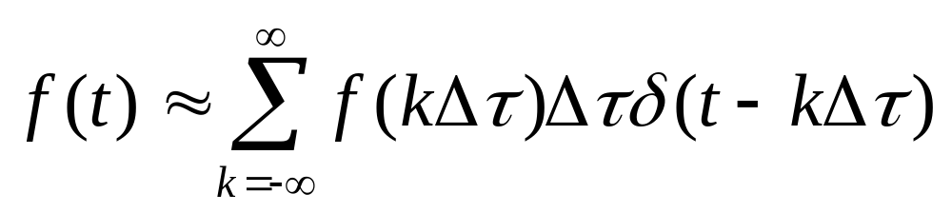
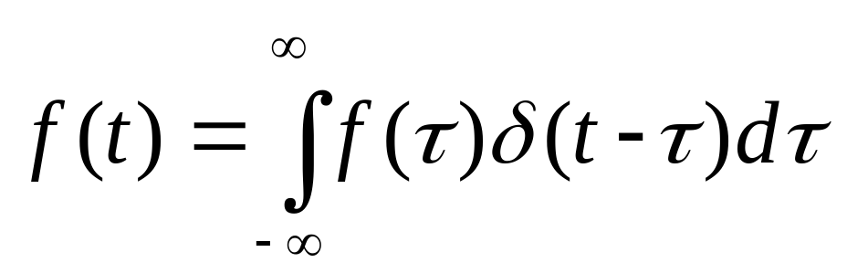
§1.3 signal representation based on δ(t)
f(t) can be approximated as follows:
The smaller of Δτ, the higher of the accuracy, and when Δτ→dτ, k Δτ →τ, the above expression becomes precision representation:

Slide 22
§1.4 Frequency domain analysis of continue-time signals
With the time domain analysis, signals are decomposed the sum of shifted and weighted δ(t) , and only system response for δ(t) is attracted attention.
With the frequency domain analysis, signals are decomposed the sum of fundamental sinωt and harmonious, and the system response for sinωt could be attracted attention only.

Slide 23
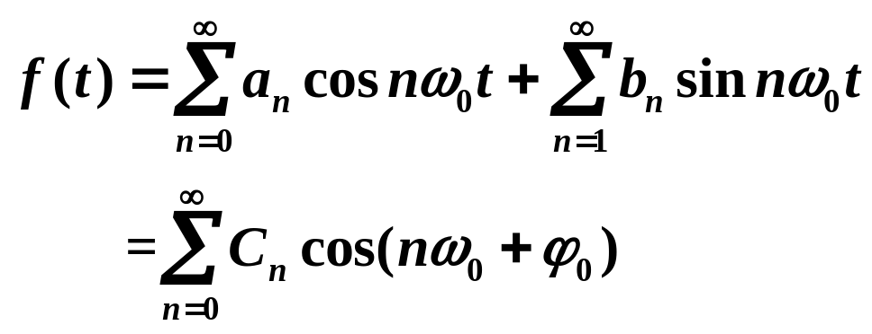

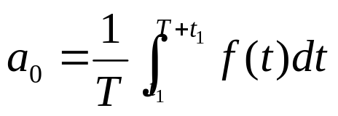
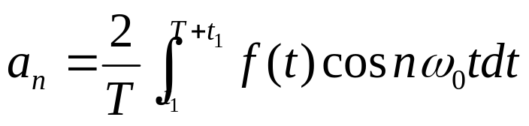
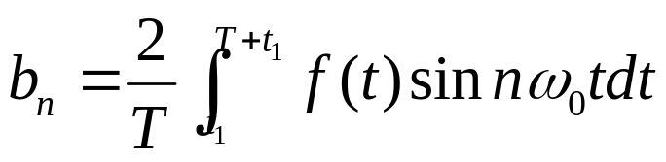
§1.4.1 Fourier series of periodic signals
Periodic signals is expanded to Fourier series
The average in one period

Slide 24
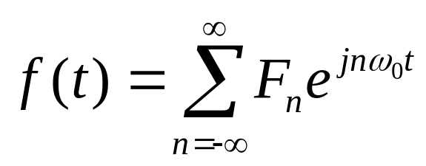
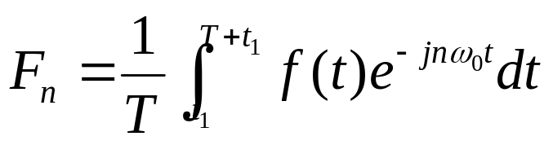

§1.4.1 Fourier series of periodic signals
Fourier series in exponential form
Fourier series represent that the periodic signals are
composed of different harmonic components .
are called spetral coiffeicents.

Slide 25
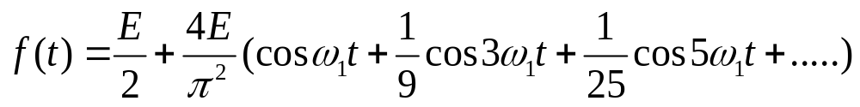

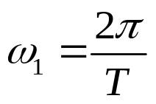











§1.4.1 Fourier series of periodic signals
f(t)
Example:
E
-1/2
1/2
t

Slide 26
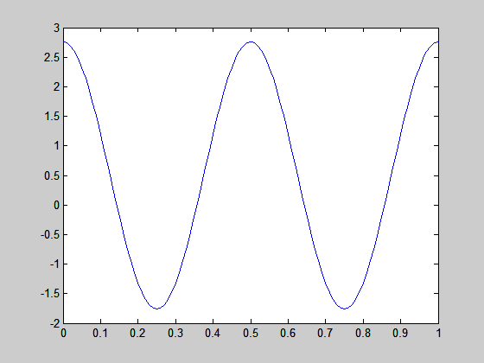

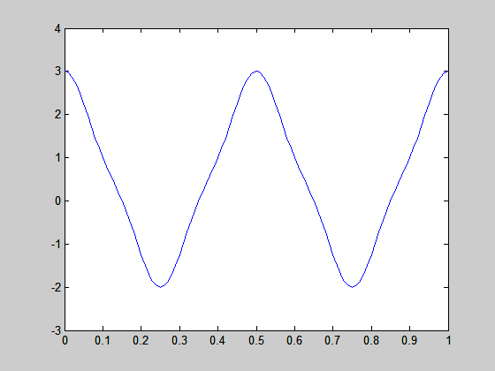
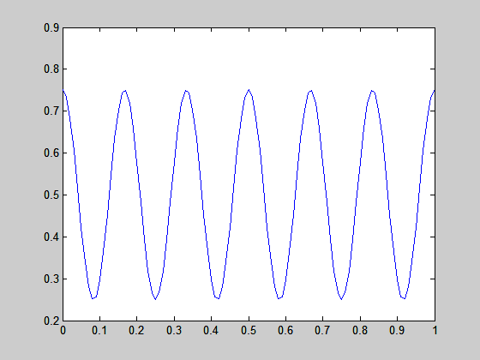


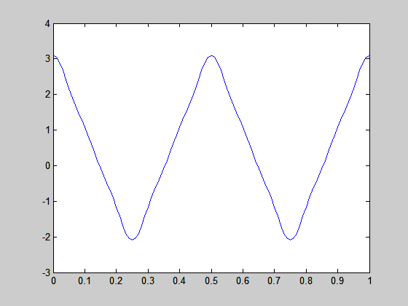
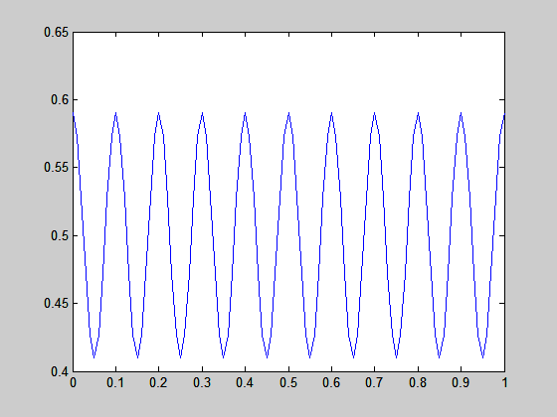


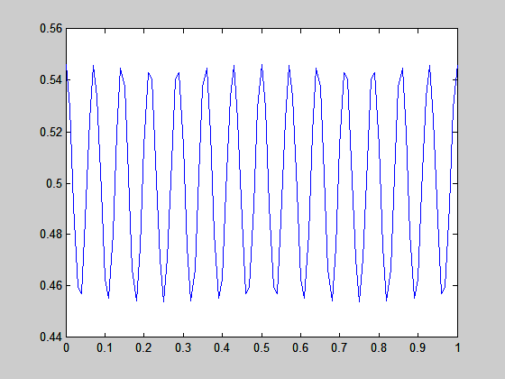

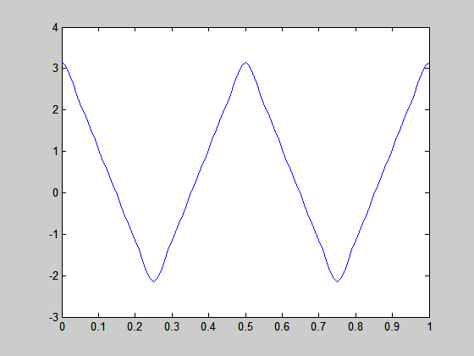
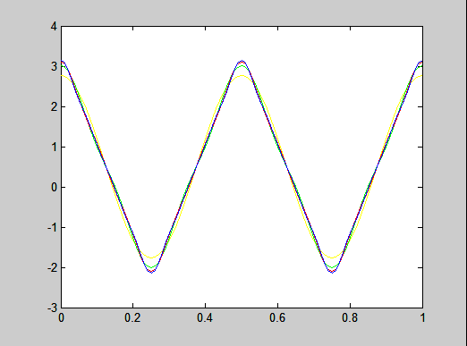

Slide 27
§1.4.1 Fourier series of periodic signals
Periodic rectangles with period T, duration τ, and amplitude A:
f(t)
A
-T
-τ /2
τ/2
T
t

Slide 28
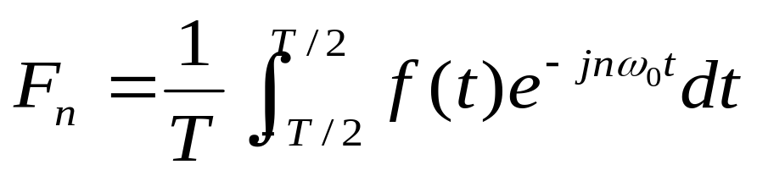
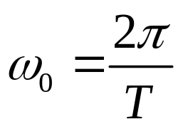
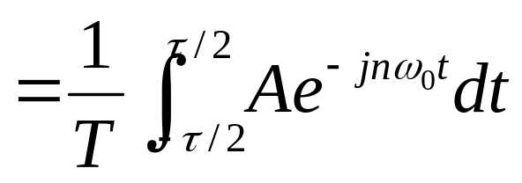
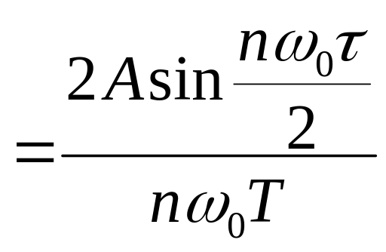
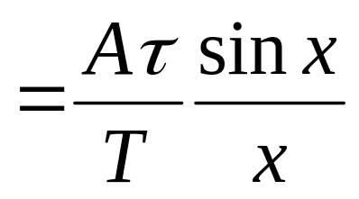
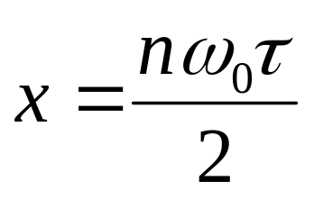
§1.4.1 Fourier series of periodic signals

Slide 29
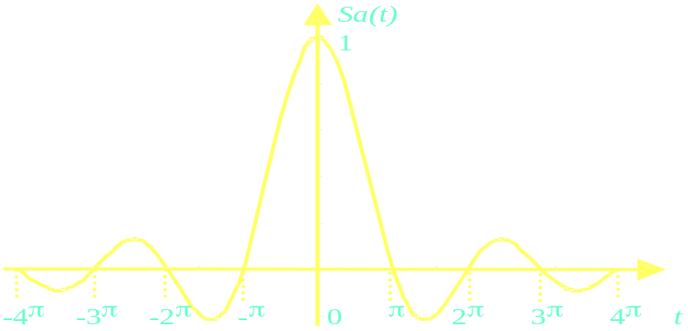
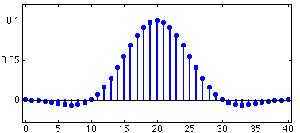
§1.4.1 Fourier series of periodic signals
Sampling function :
Sa(t) = sint/t
F_{n} = (Aτ/T)Sa(nω₀τ/2)

Slide 30
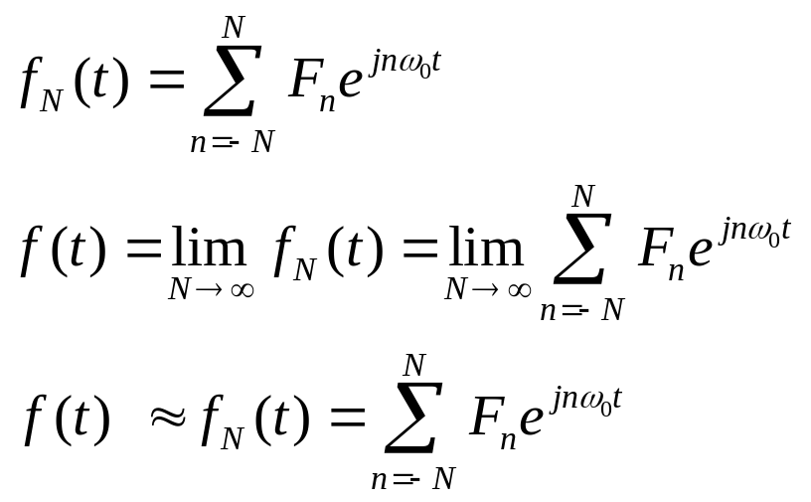
§1.4.1 Fourier series of periodic signals
Gibbs phenonemon:
In practical applications, we often use limit components of Fourier series to describe the periodic signals,

Slide 31
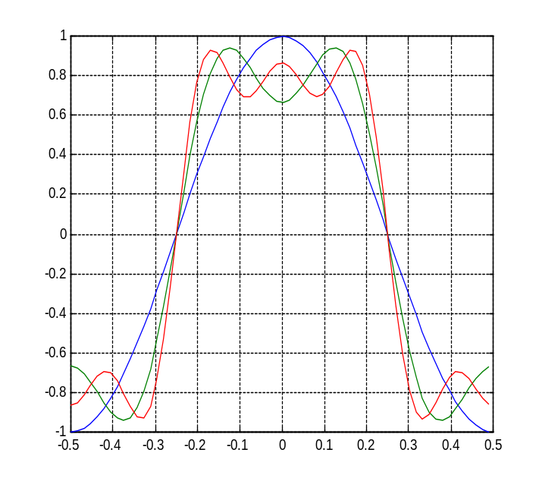
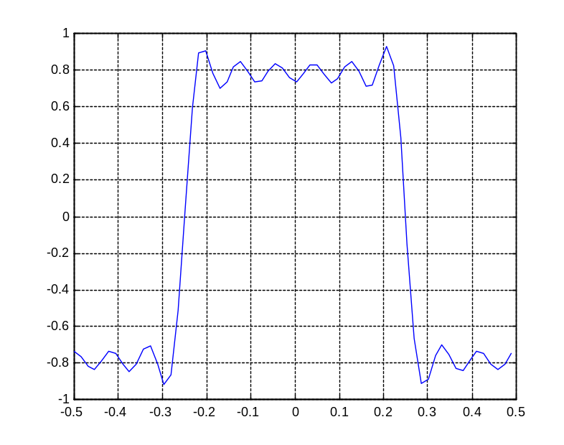
E/2
-1/4
1/4
t
-E/2
N=2
N=3
N=11
N=1
N=1

Slide 32
§1.4.1 Fourier series of periodic signals
N increase, the ripples in the partial sums become compressed toward the discontinuity, and the error becomes small, but ,for any finite value of N, the peak amplitude of the ripple remains constant. Overshoot of 9% of the height of the discontinuity. This behavior is known as the Gibbs phenomenon

Slide 33
§1.5 Fourier analyses of non-periodic signals—Fourier Transform
When T→ ∞ ,
the signal is becoming non-periodic:
ω₀= 2π/T
But T→ ∞ , F_{n} and ω₀ → 0，the amplitude of lines and the distance between lines tend to 0. It is unreasonable to describe the signal with frequency lines. So the concept of spectrum density is introduced.

Slide 34
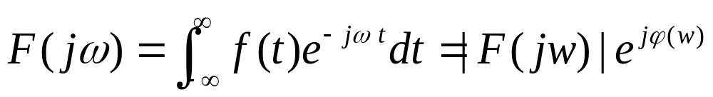
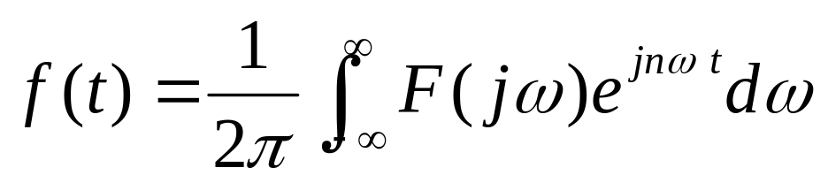
Fourier Transform Pair

Slide 35
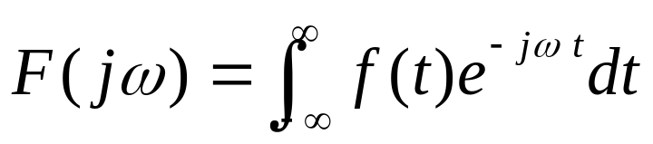
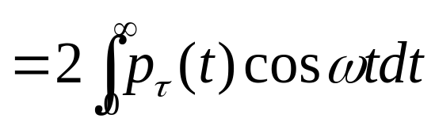
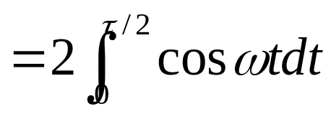
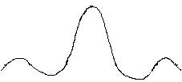
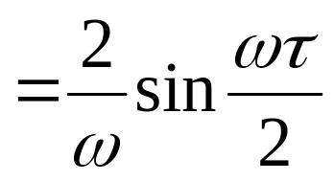
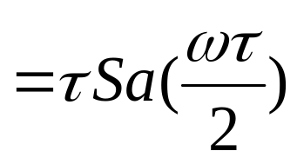
§1.8 Fourier Transform of typical signals
Gate
1
-τ/2
τ/2
F(jω)
τ
2π/ τ
4π/ τ
ω

Slide 36
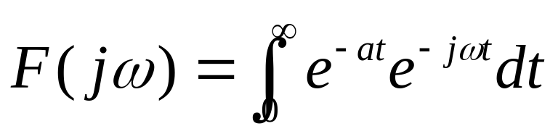
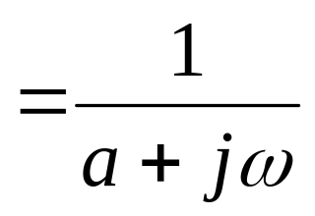

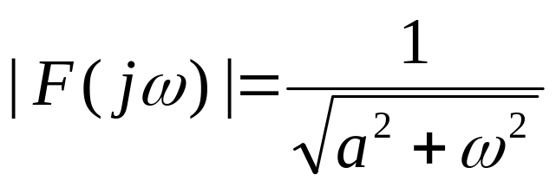

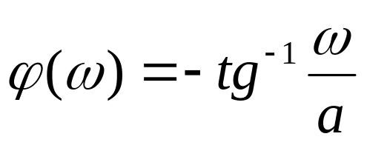
§1.8 Fourier Transform of typical signals
Exponential f(t) = e^{-at} u(t) a>0
e^{-at} u(t)
t
|F(jω)|
1/a
ω

Slide 37

§1.8 Fourier Transform of typical signals
Unit impulse δ(t)
δ(t)
|F(jω)|
1
0
t
t
ω
0
Unit impulse has uniform frequency density in whole frequency range, that means it has infinite wide band.

Slide 38
§1.9 Fourier Transform of typical signals
Constant 1
1 ←→ 2πδ(ω)
This result could be got directly based on the symmetry of Fourier Transform.
Constant 1 represents direct current signal, and its spectrum is non-zero only at ω = 0, which is a δ(ω)

Slide 39



§1.9 Fourier Transform of typical signals
Sin and cos function
Based on the transform pair 1 ←→ 2πδ(ω) and δ(t) ←→ 1, we have some important conclusions:
F[cos ω₀t]
F[sin ω₀t]
(π)
(π)
(jπ)
ω₀
-ω₀
ω₀
-ω₀
(-jπ)

Slide 40



§1.9 Fourier Transform of typical signals
Unit impulse sequence
δ_{T}(t)
δ_{ω0}(ω)
ω₀
-2 ω₀
- ω₀
0
-2T
-T
ω₀
2 ω₀
ω
0
T
2T
t
ω₀ = 2π/T

Slide 41



§1.10 Properties of Fourier Transform
Linear:
af₁(t) + bf₂(t) ←→ aF₁(jω) + bF₂(jω)
Time shift
Frequency shift (Modulation theorem)
Energy theorem

Slide 42

§1.10 Properties of Fourier Transform
Convolution theorem
f₁(t)*f₂(t) ←→F₁(jω) F₂(jω)
f₁(t) f₂(t) ←→1/(2π)F₁(jω) *F₂(jω)
Where:

